Slide 1
BDM Project Presentation Optimization of Inventory, Financial Conditions and Customer Retention of “G Mega Mart”
Pushpak Ruhil
21F2001180
September 2022 Project

Slide 2
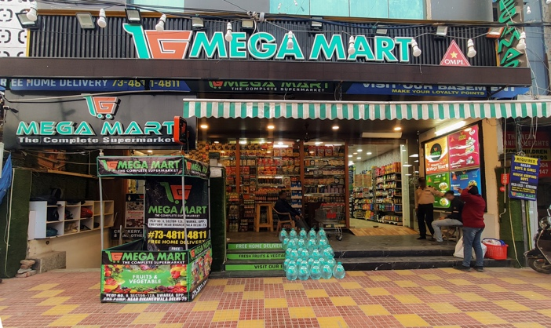
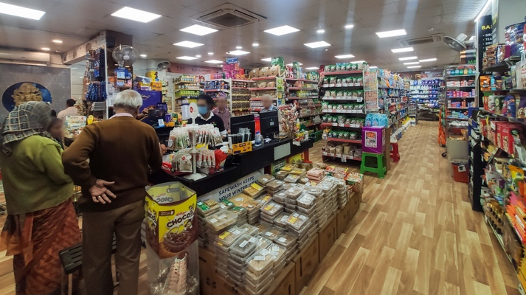
Project analysis slide 3
Project and The Business
Project:
Reach out some business, collect data and analyze for the problems
Only primary data
Business:
Super-mart in Dwarka, New Delhi
Deals in all sorts of FMCG
Acquired in mid June, 2022
19 employees under the key stakeholders
In-store & home delivery; Website & app under development

Slide 3






Project analysis slide 3
Analysis Process
ASK
PREPARE
PROCESS
ANALYZE
SHARE
ACT
The analysis process followed is Google’s 6 step data analytics process.

Slide 4
Problem Statements
During the ”Ask” phase, 3 problems were concluded to be worked upon for the analysis.
The 3 problems are:
Customer Retention of the business
Profit earned and loss incurred by the business
Management of the inventory
Customer Retention Problem: The business expected insights on what the current customer retention is and how this can be improved
Profit/Loss Problem: The business has been facing losses since some time. So, they expected insights on the general revenue, profit and losses.
Inventory Management Problem: The business expected insights on the SKUs available. Insights on the SKUs performing poor would help them function better.
The data available for the analysis was from June 2022 to January 2023.
A total of 5 excel sheets available: Customer related data, Mama Earth’s SKUs Oct data, category wise stocks data, monthly company wise revenue

Slide 5
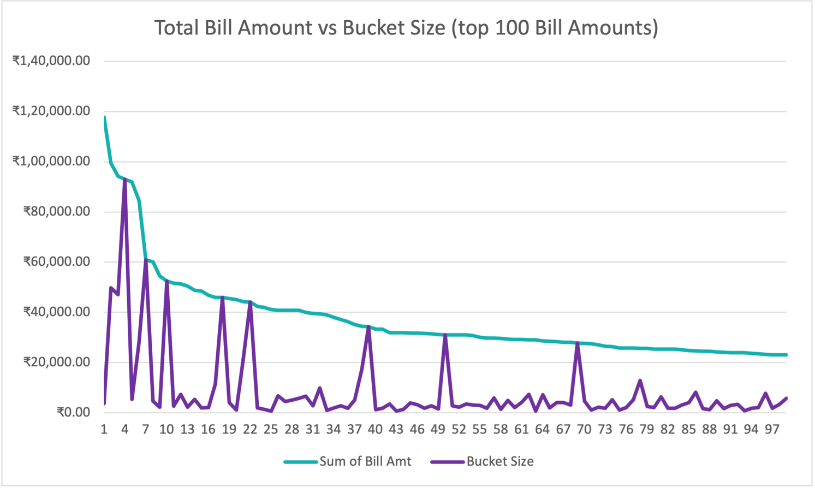
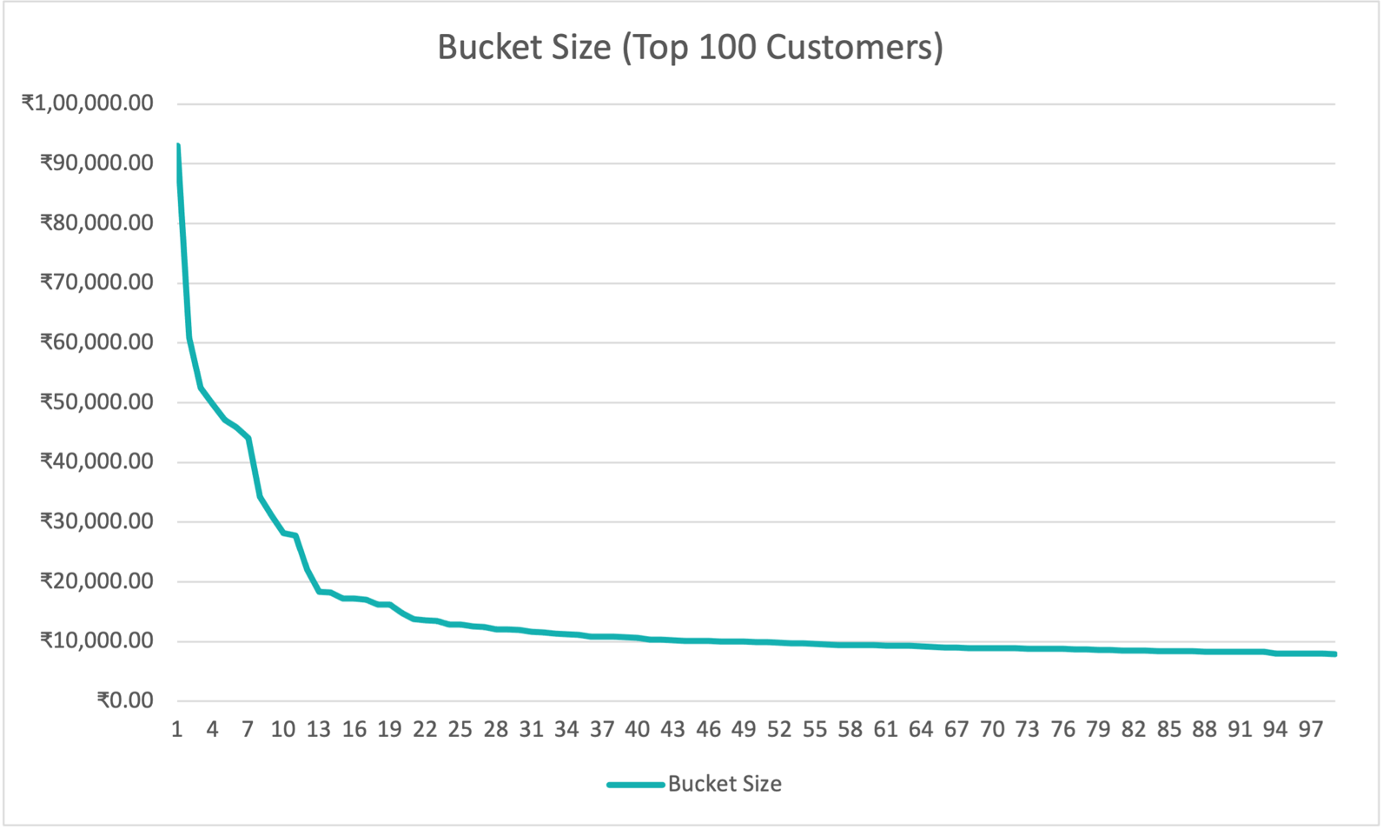
Customer Retention
Top 100 customers sorted
based on the total bill amount
Top 100 customers sorted
on the bucket size
Maximum bucket size from June 2022 to January 2023 was of Rs. 93,000/- but the corresponding number of invoices was 1
Customer with maximum bills(57) in the available data (June 2022-January 2023) has the bucket size @ Rs 65.32/-
The customer with the 2nd maximum bills(56) has a bigger bucket size @ Rs 734.77/-

Slide 6
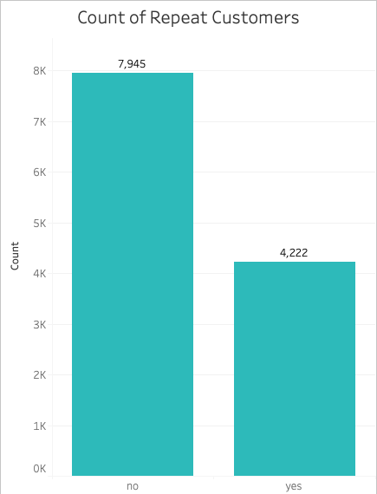
Customer Retention
Customer retention rate turns out to be 0.347
i.e., CR = 35% (approx.)
The bar chart shows the ratio of multiple visit customers v/s single visit customers
But…
The data is not 100% accurate. Why?
2 reasons…

Slide 7
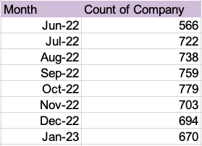
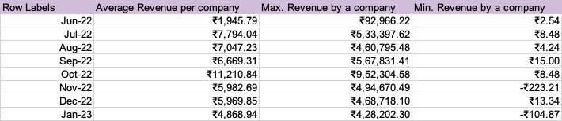
Revenue, Profit & Loss
Some key insights based on the monthly aggregation.
Maximum number of companies were recorded in October 2022 and the maximum revenue per company generated was also in October 2022
Notes:
This gives us the count of unique companies having their SKUs in the respective month.
For example, in October 2022, there were 779 different companies/brands, which were selling multiple products in the month

Slide 8
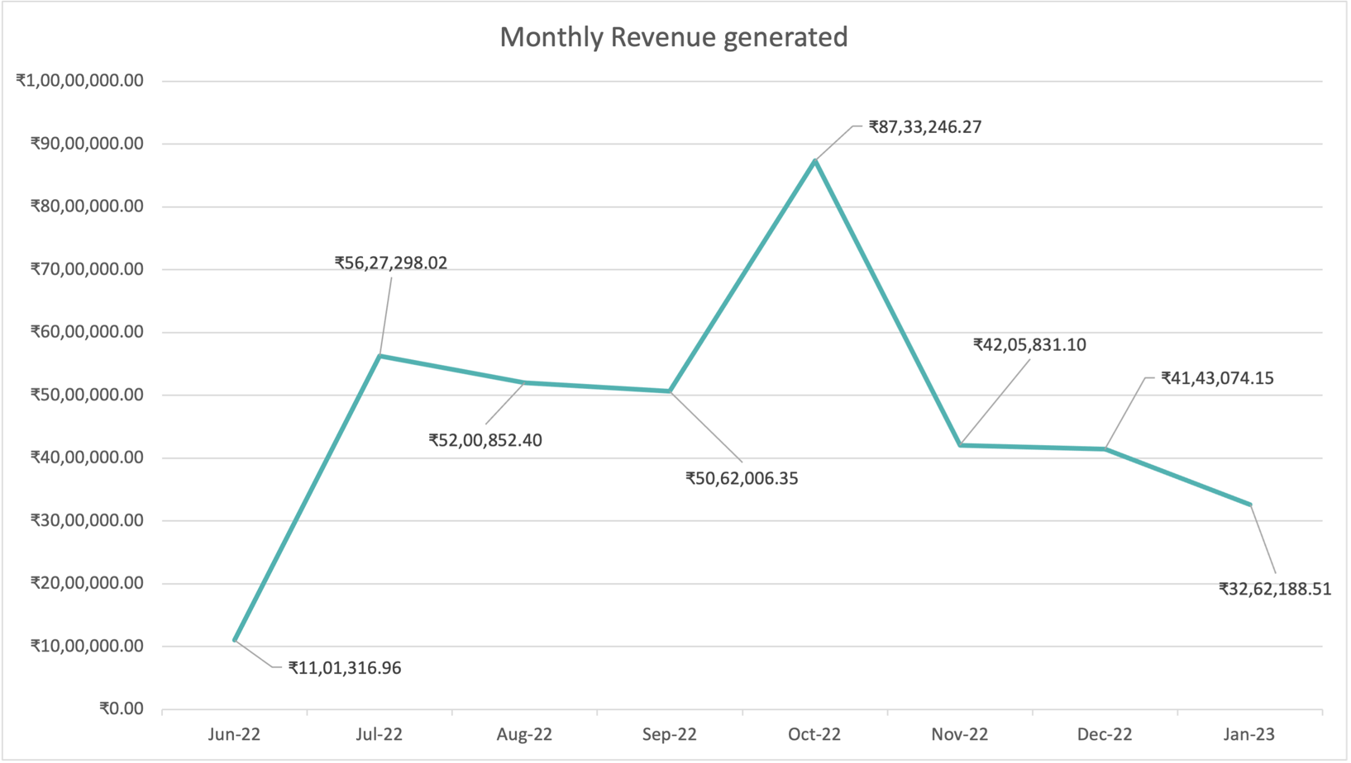
Revenue, Profit & Loss
The line chart shows us the trends on the monthly revenue generated
It can be inferred that after Oct, 2022 (when the revenue was the maximum), the revenue has been declining.

Slide 9
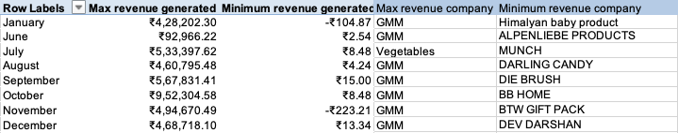
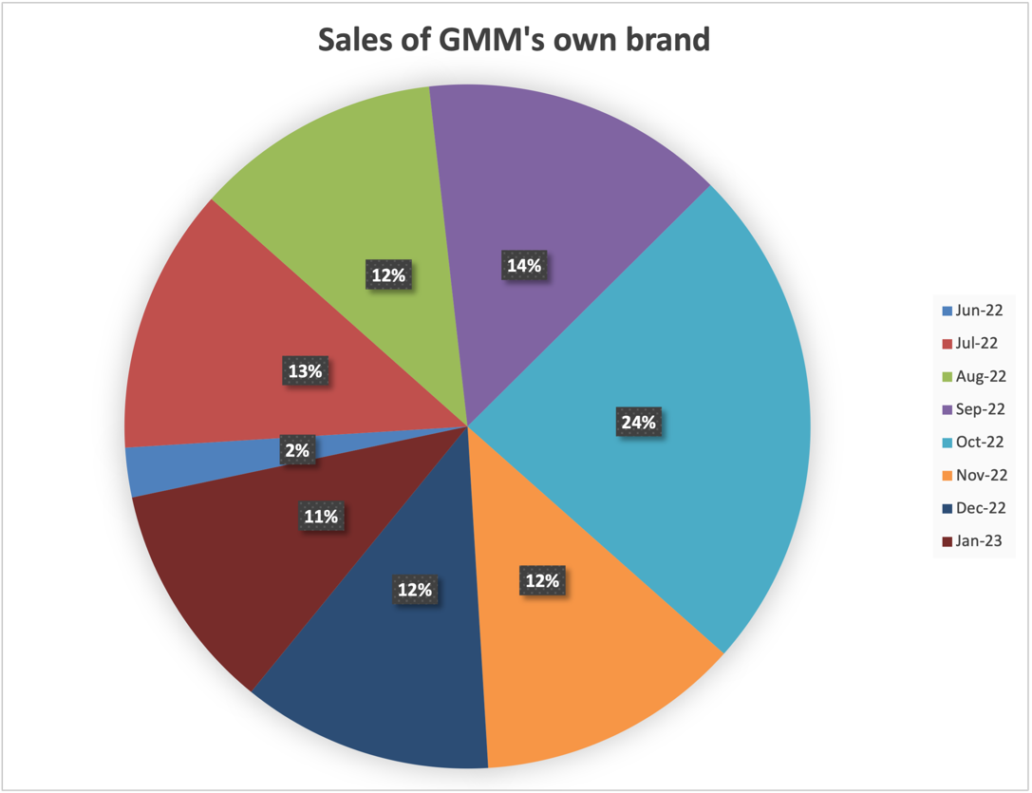
Revenue, Profit & Loss
From the table to the right, it is clearly evident that the maximum profit is generated by the home-brand of GMM. This profit is roughly 60%
From vegetables, though, the profit generated is about 15-20%
In the pie chart, the whole (100%) is equal to ₹39,63,784.44

Slide 10
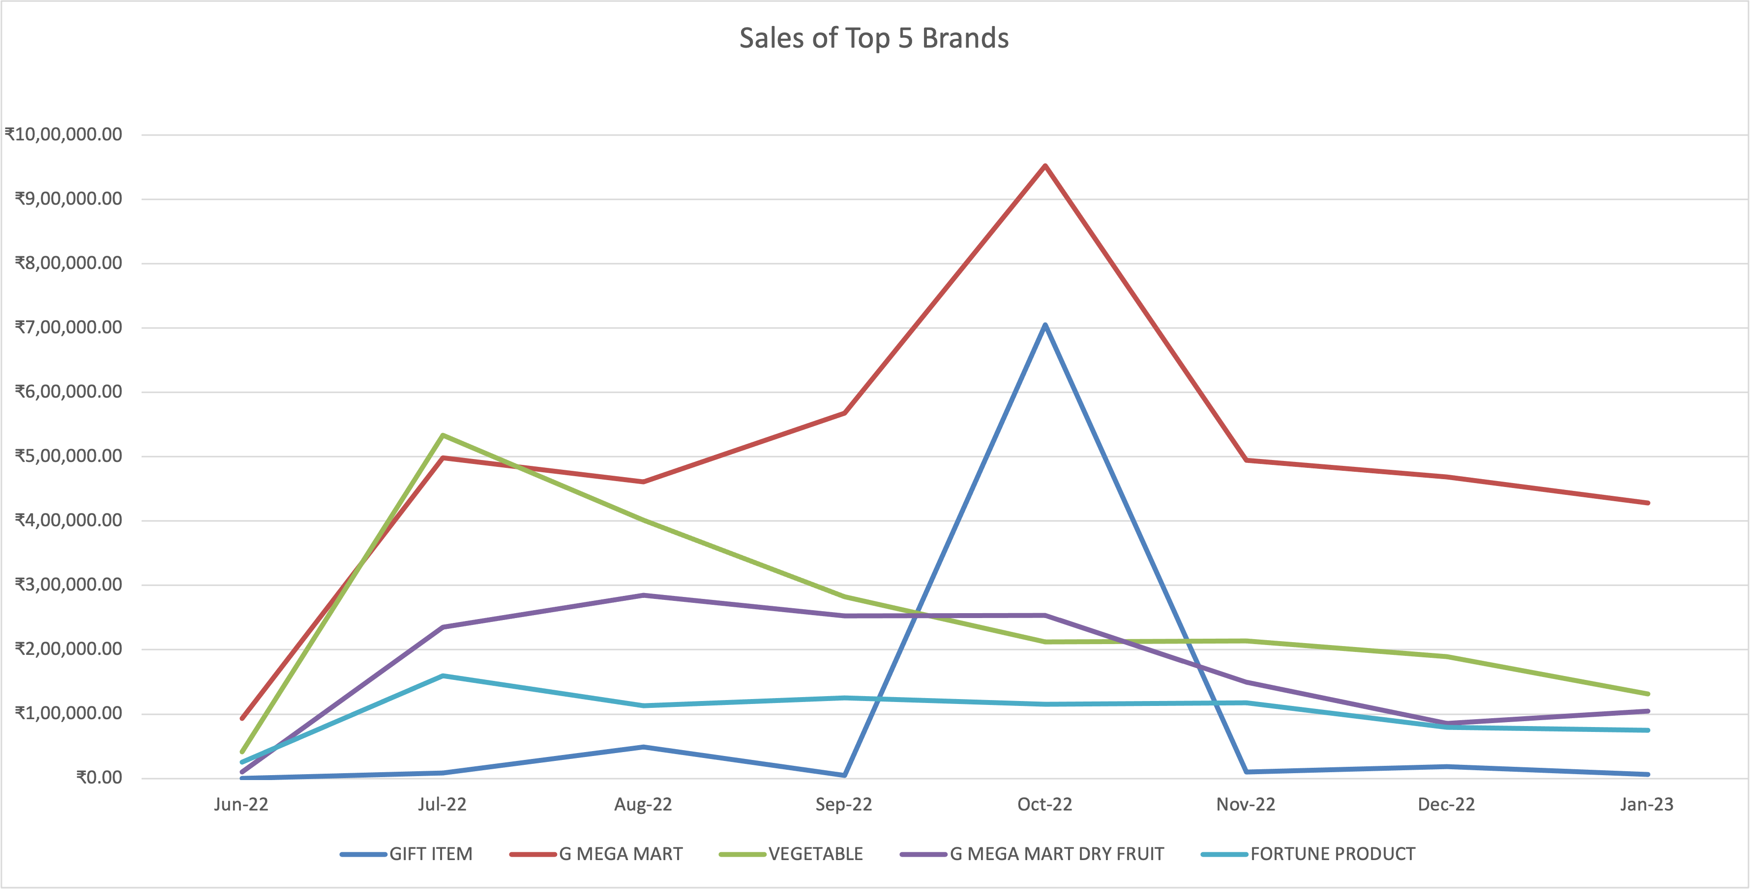
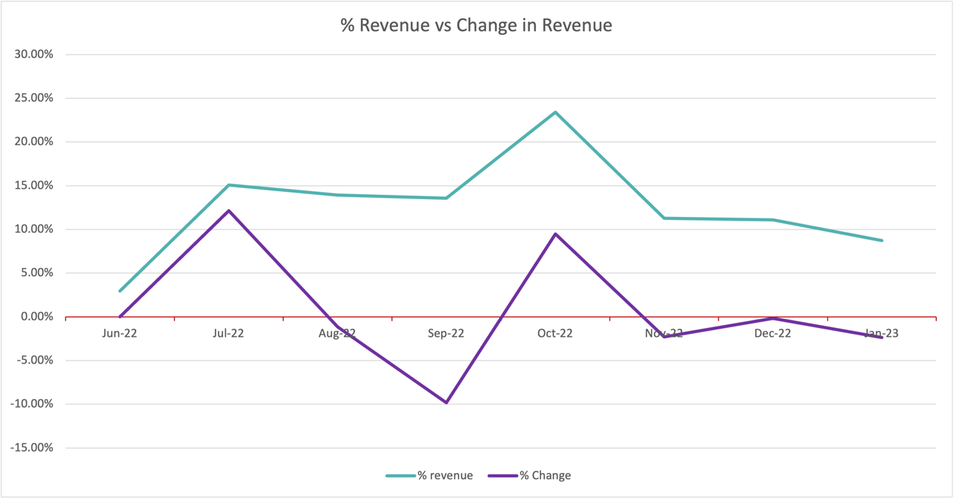
Revenue, Profit & Loss
Sales of top 5 brands over the months can be seen with the line chart to the right.
% Revenue vs Change in Revenue

Slide 11
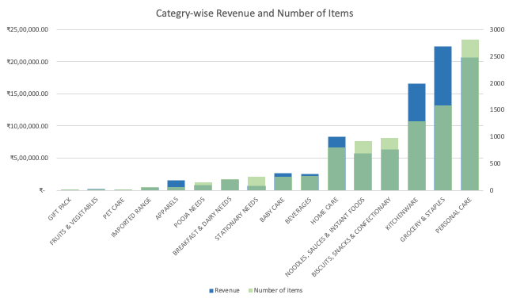
Inventory Management
Merging both the previous graphs together to see a clear picture.
Total of 9663 SKUs available
Under the “Personal Care” category (2812), most SKUs are for the “Skin Care” sub-category (1347).
The category responsible for maximizing the revenue is “ Grocery and Staples”.
“Badam Salora 1kg” is the product responsible for regenerating the maximum revenue of worth ₹1,20,120/- (A product of GMM home brand)

Slide 12
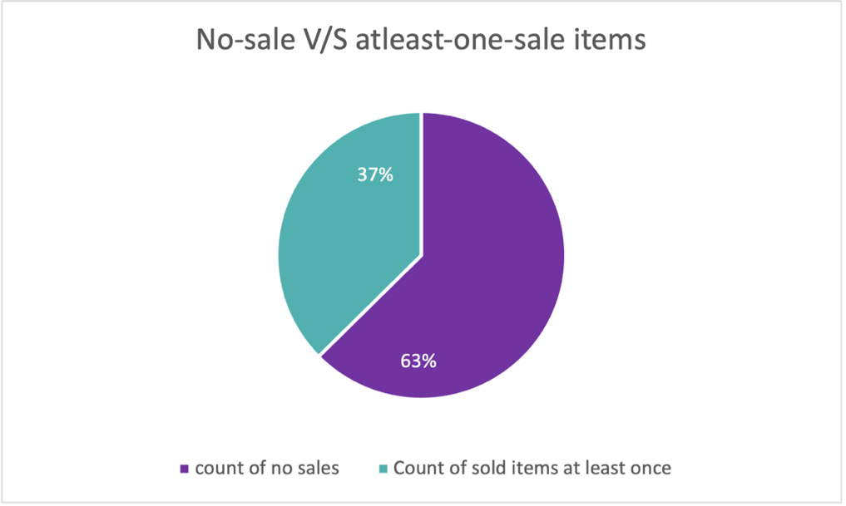
Inventory Management
There is a total of 151 SKUs which generate no revenue at all. These SKUs are just sitting in the inventory costing the company resources.
Apart from this, there is a total of 902 SKUs which individually generate revenue of less than ₹100/-
We previously saw that October 2022 had the maximum sales and revenue generation. But even after that, there were a lot of no-sale SKUs.
Data sheet of Mama Earth’s sales was analysed for figuring out the no-sale SKUs of a particular company in October 2022.
There are a total of 184 SKUs of Mama Earth(ME) brand, which resulted in no sales at all during October 2022. Such products should be analyzed over other months to get stronger insights and take relevant action.
The results were sorted based on the DII, and the maximum DII was at 217 days for a product with the name “ME MILKY SOFT FACE CREAM 60G”.
10 products with DII more than 100.
Notes:
Such products should be taken into consideration as to who is buying them, what are the other products purchased with them so that we can create a system where we can club these products along with the other buying habits of the customer to promote sales.

Slide 13
Recommendations
Some recommendations that can be taken into consideration for all the problems:
Customer Loyalty card
Analyze competitor’s price charts
Psychological tricks used by competitors
Close eye on SKUs close to expiration
Other suggestions based on the results:
Focus on increasing sales during off-peak season
Expand GMM’s home brand’s product line
Investigate the low sales of vegetables
Take feedback from customers and analyze that accordingly

Slide 14
Thank you

